Slide 1

Final Project Video - Movie Data Set
Kate Kang, Hannah Cheren, Devashi Ghoshal, Gary Shi

Slide 2

Introduction
What factors associated to certain movies more successful than others?
Question of Interest: Is there a positive, linear relationship between a movie’s budget and its respective gross revenue or score received?
Thesis: although the size of a movie's budget could be important to a movie's success, we don’t believe that there is necessarily a relationship between budget and a movie’s success.

Slide 3
Background
“Movie Industry: Three decades of movies”
Budget: the budget of a movie
Gross: the gross revenue the movie made in total
Score: a score on a scale of 1 to 10

Slide 4

Linear model assumptions
Linearity
Homoscedasticity
Independence
Normality

Slide 5
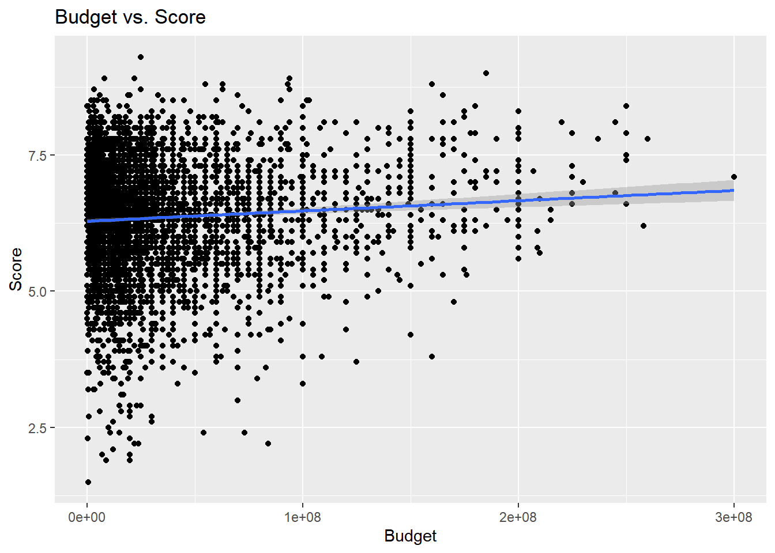
Budget vs Score
r = 0.074
(score) =
6.3 + 1.9E-9 x (budget)

Slide 6

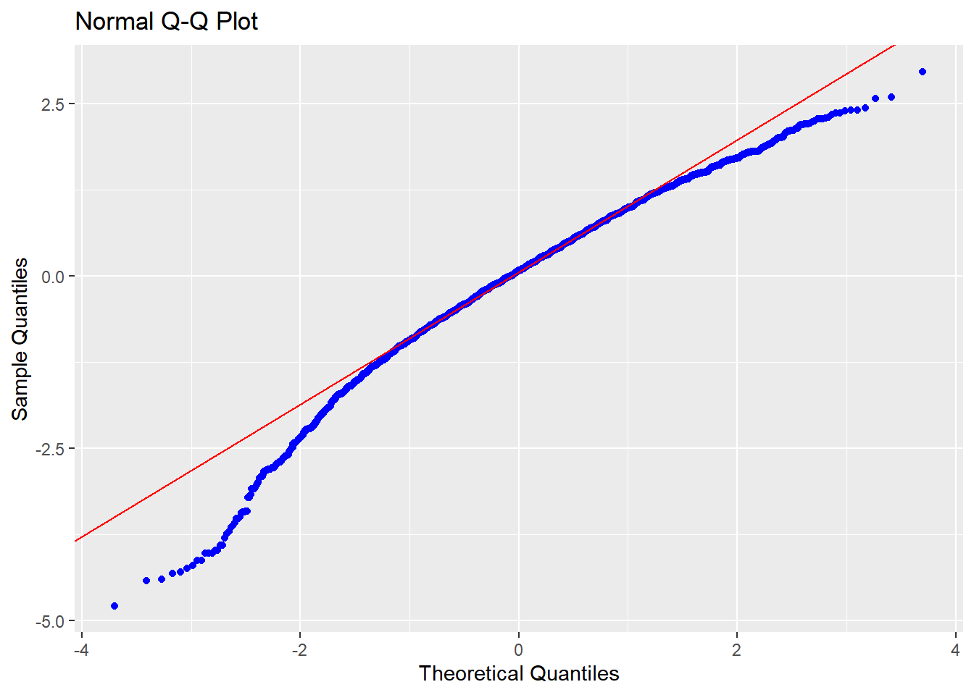
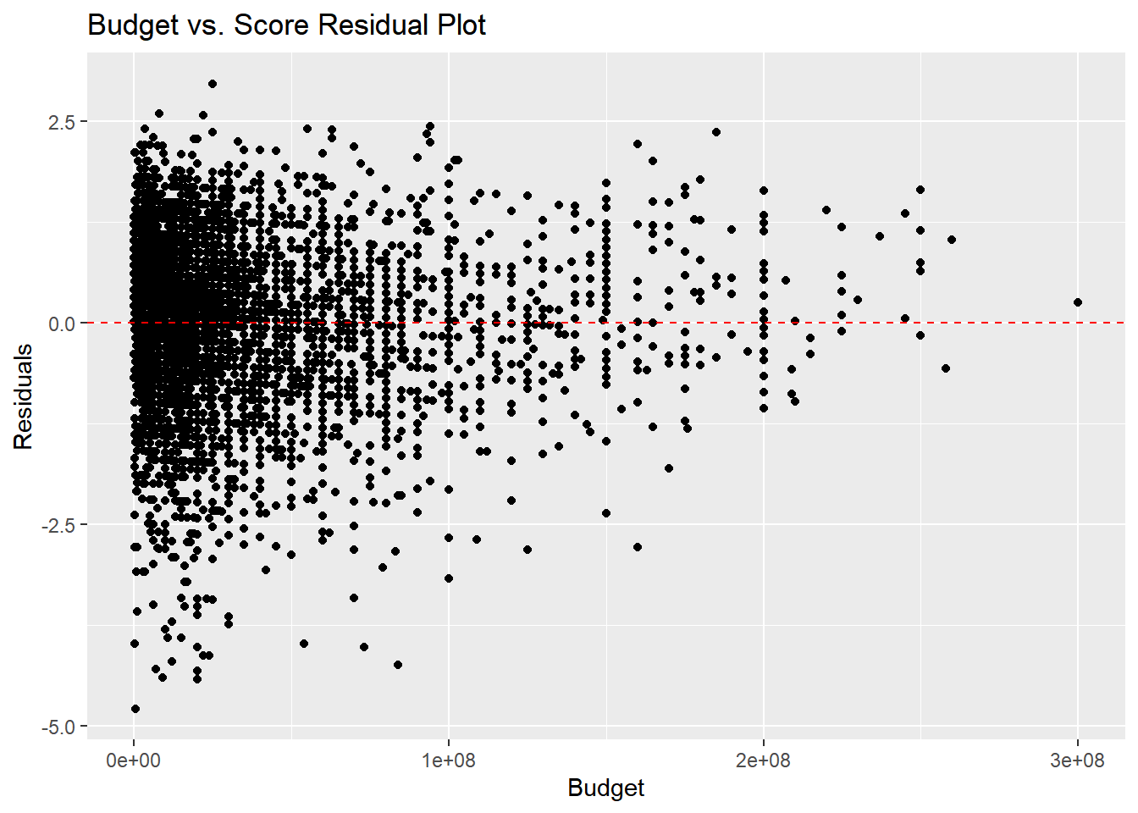
Assumption check
Homoscedasticity
Normality

Slide 7
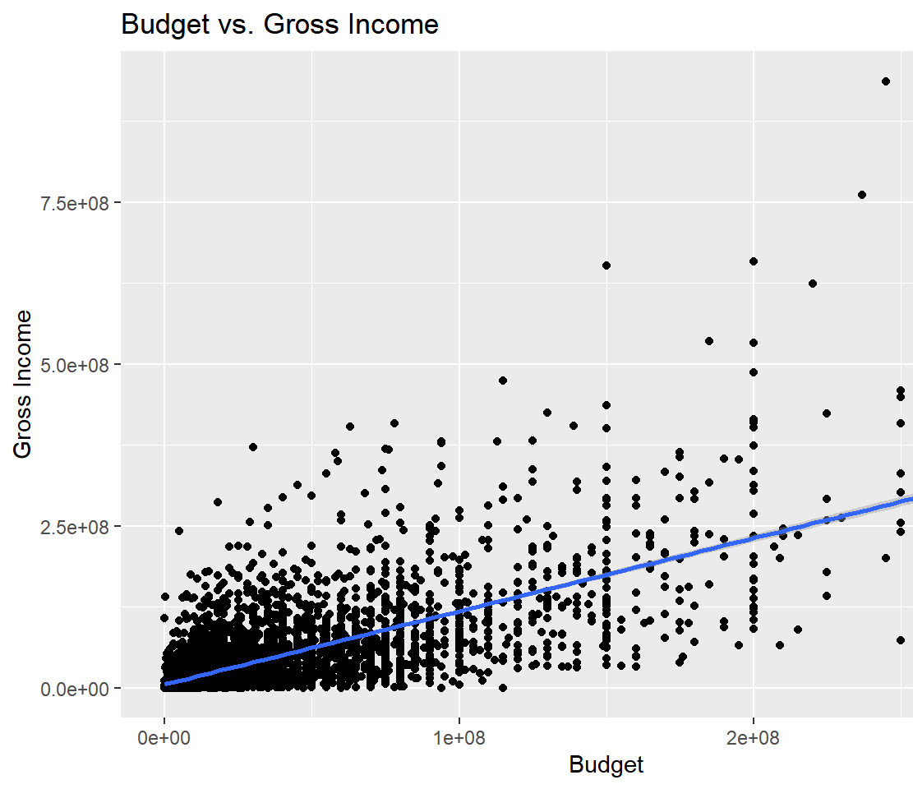
Budget vs Gross Income
r = 0.68
(gross income)
= 540000 + 1.1 x (budget)

Slide 8

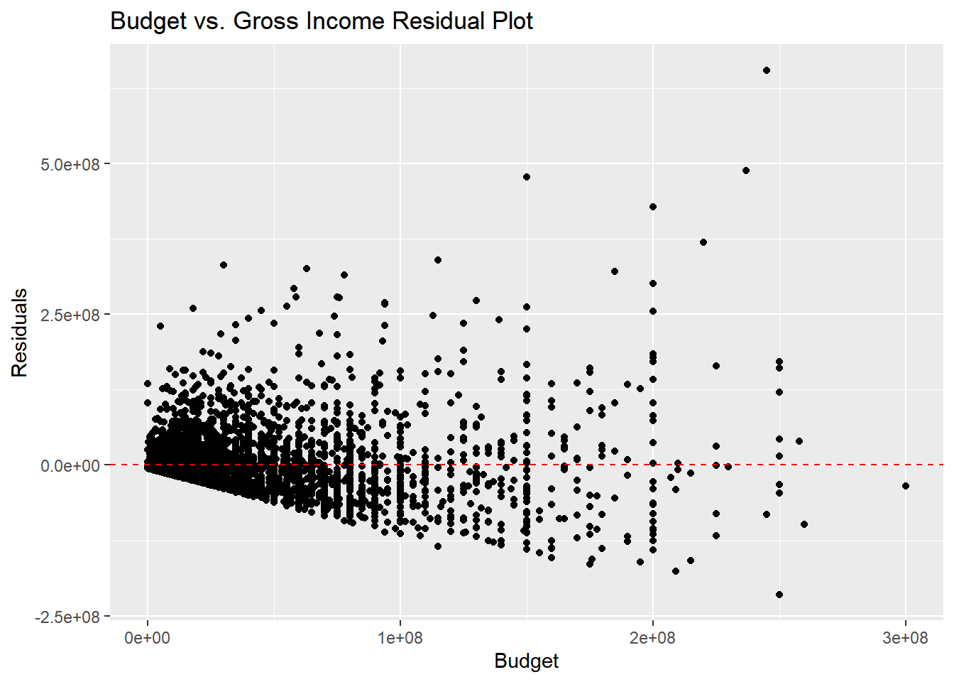
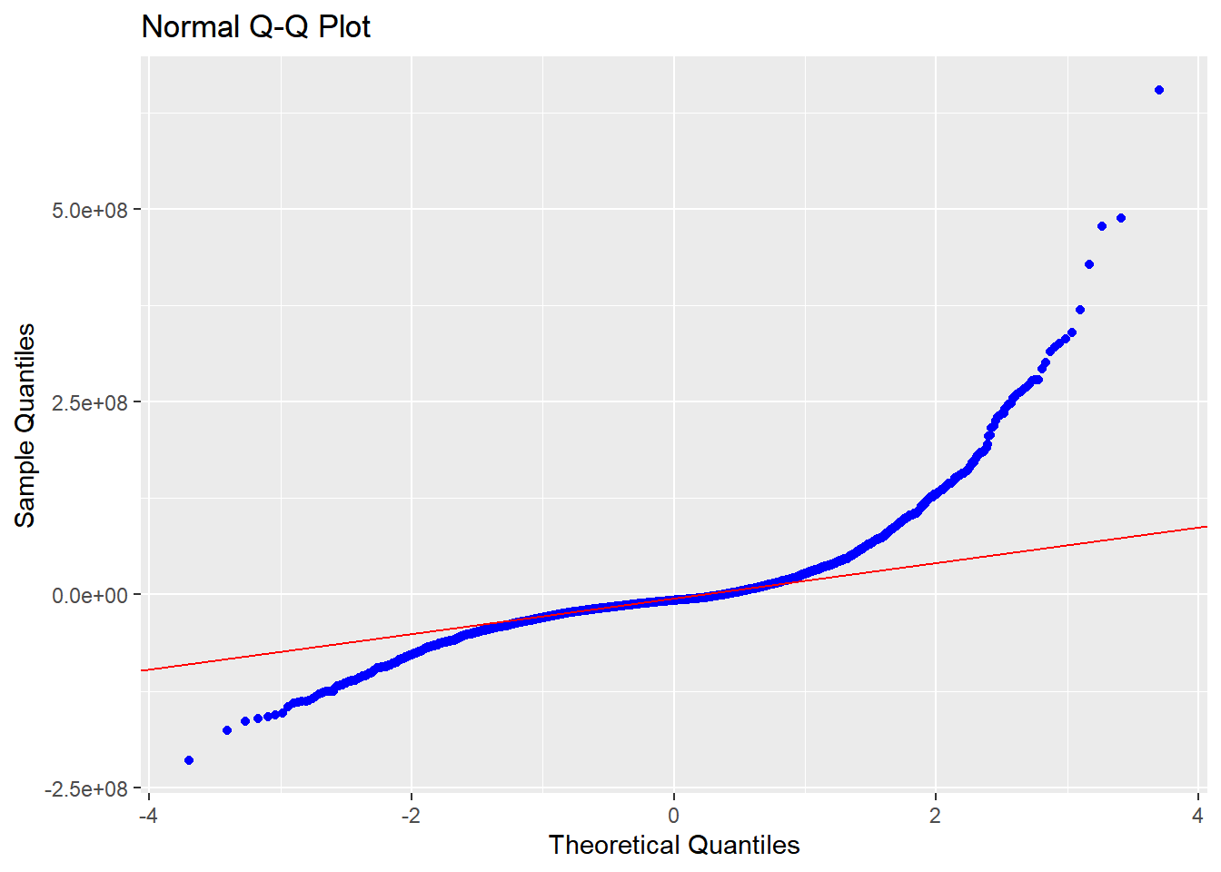
Assumption check
Homoscedasticity
Normality

Slide 9
Conclusion
Budget vs. Score
Budget vs. Gross Income
Week positive linear relationship
Linear assumptions succeed
Moderate strong positive linear relationship
Linear assumptions fail
Is there a positive, linear relationship between a movie’s budget and its respective gross revenue or score received?

Slide 10
Reference
https://www.kaggle.com/danielgrijalvas/movies
https://www.dreamstime.com/hypothesis-basic-assumption-light-bulb-line-art-icon-apps-websites-hypothesis-basic-assumption-light-bulb-image201124841

